Slide 1


Organizational Behavior
(MGT-502)
Lecture-16

Slide 2
Today’s Topics

Slide 3
Review Part-I

Slide 4
Basic OB Model
Organization
systems level
Group
level
Individual
level

Slide 5
Part-I The Individual
Ability & Learning
Values, Attitudes and Job Satisfaction
Personality & Emotions
Perception & Individual Decision Making
Basic Motivation Concepts
Motivation and its Applications

Slide 6
Part-II The Group
Foundation of Group Behavior
Group and Team Work
Functions of Communication
Basic Approaches to Leadership
Contemporary Issues in Leadership
Power and Politics
Conflict and Negotiation

Slide 7
Part-III The Organization System
Organizational Structure
Work design and Technology
HR Policies and Practices
Organizational Culture
Organizational Change
Stress Management

Slide 8
Organizational Behavior

Slide 9
The study of individual behavior and group dynamics in organizational settings

Slide 10
Forces reshaping the process of management

Slide 11

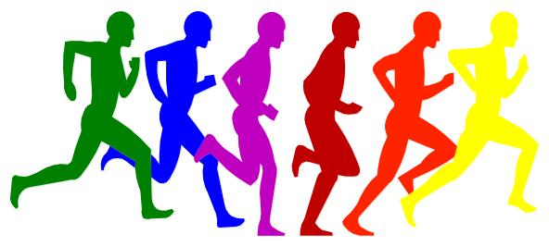
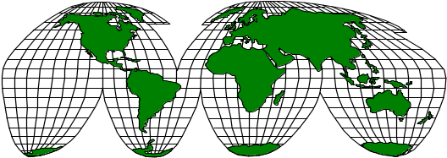
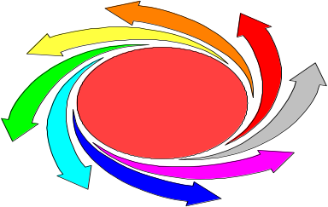
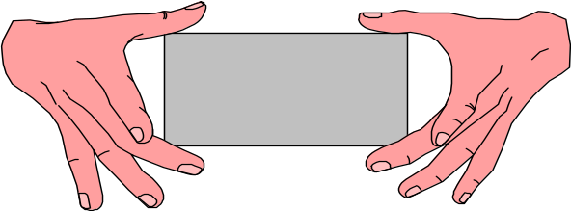
Power of Human Resources
Cultural Diversity
Globalization
Employer-
Employee
Rapid Change
New Psychological Contract

Slide 12
Organizational Behavior
The study of individual behavior and group
dynamics in organizational settings
Organizational Variables
Performance appraisal Work design
Communications
Human Behavior
Organizational Design
Organizational Structure Jobs
Notes:
2

Slide 13
Behavior is a function of both the Person and the Environment.
B = f (P/E)

Slide 14
Why Do We Study OB?

Slide 15
To learn about yourself and how to deal with others
You are part of an organization now, and will continue to be a part of various organizations
Organizations are increasingly expecting individuals to be able to work in teams, at least some of the time
Some of you may want to be managers or entrepreneurs

Slide 16
Understand
organizational
events
Organizational
Behavior
Research
Influence
organizational
events
Predict
organizational
events

Slide 17
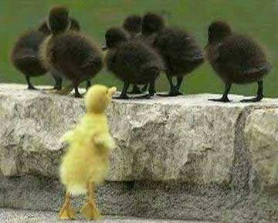
OB
Systematic study of how people behave in organizations

Slide 18
What Managers Do?
Gets things done through other people
Make decisions, allocate resources, and direct the activities of others to attain goals
Do their work in an organization

Slide 19
What is an Organization?

Slide 20
What are organizations?
Social entities
Goal oriented
Deliberately structured
Linked to the external environment

Slide 21
Challenges for
Today’s Organizations
Globalization
and Culture
High Quality
and Low Cost
Multiple
Stakeholders
Rapid Pace
of Change
Notes:
17

Slide 22
Understanding the Basics of Human Behavior

Slide 23
Heredity
Environment
Individual
Differences
Framework
Abilities
and Skills
Values
Work-Related
Attitudes
Work-Related
Behaviors

Slide 24
Variables Influencing
Individual Behavior

Slide 25
The Person
Skills & abilities
Personality
Perceptions
Attitudes
Values
Ethics
The Environment
Organization
Work group
Job
Personal life
Behavior
B = f(P,E)

Slide 26
Types of work-related behaviour
Joining the
organisation
Types of
work-related
behaviour
Exhibiting
organisational
citizenship
Remaining
with the
organisation
Performing
required
tasks
Maintaining
work
attendance

Slide 27
Why Do We Care?
Ability
PERFORMANCE
Opportunity
Motivation
Performance =
f (Ability, Motivation, Opportunity)

Slide 28
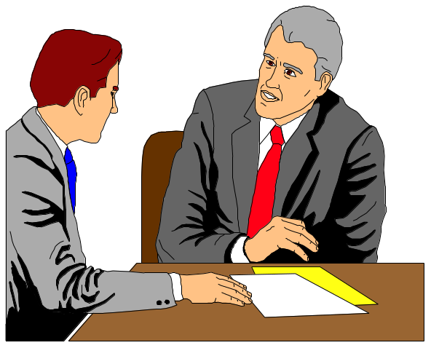
The Person-Job Fit
Person-Job Fit
  The extent to which the contributions made by the individual match the inducements offered by the organization.

Slide 29
Ability
Mental and physical capabilities to perform various tasks.

Slide 30
Intellectual Abilities
The capacity to do mental activities

Slide 31
Learning
A relatively permanent change in the behavior occurring as a result of experience.

Slide 32
Learning Theories
Social
Learning
Classical
Conditioning
Operant
Conditioning

Slide 33
Values

Slide 34
The Importance of Values
Behavior
Motivation
Perceptions
Attitudes
Values

Slide 35
Values, Ethics & Ethical Behavior
Value Systems - systems of beliefs that affect what the individual defines as right, good, and fair
Ethics - reflects the way values are acted out
Ethical behavior - actions consistent with one’s values
Notes:
22

Slide 36
Values, Loyalty, and Ethical Behavior
Ethical Climate in
the Organization
Ethical Values and Behaviors of Leaders

Slide 37
Work Values
Achievement (career advancement)
Concern for others (compassionate behavior)
Honesty (provision of accurate information)
Fairness (impartiality)
Notes:
16

Slide 38
Values Across Cultures
Power Distance
Individualism or Collectivism
Quantity or Quality of Life
Uncertainty Avoidance
Long-Term or Short-Term

Slide 39
Components of Attitudes
Cognitive -- thinking
Affective -- feeling
Behavioral -- doing

Slide 40
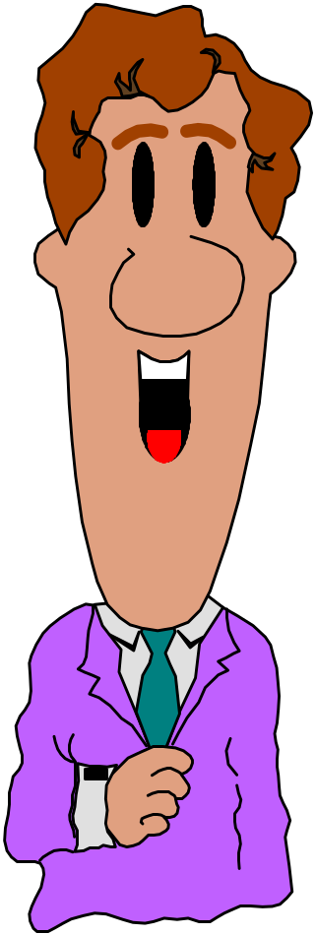
Types of Attitudes
Job satisfaction
Job involvement
Organizational commitment

Slide 41
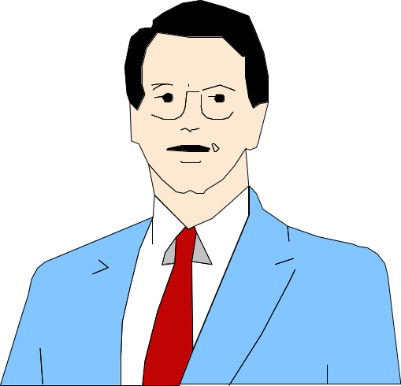
Attitudes Associated with Job Satisfaction
Work Itself
Job Security
Co-workers
Supervision
Promotion Opportunities
Working Conditions
Pay

Slide 42
Barriers to Change Attitudes
Prior Commitments
Insufficient Information

Slide 43
Personality
Mean how people affect others and how they understand and view themselves, as well as their pattern of inner and outer measurable traits and
Person-situation interaction

Slide 44
Both personality and attitudes are complex cognitive processes. The difference is that personality usually is thought of as the whole person, while attitudes may make up the personality.

Slide 45
Some Major Forces Influencing Personality
Cultural forces
Individual
Personality
Social class and other group membership forces
Hereditary forces
Family relationship forces

Slide 46
Locus of Control
Locus of Control - personality variable that affects individual behavior
  Internal - belief in personal control and personal responsibility
  External - belief in control by outside forces (fate, chance, other people)
Notes:
23

Slide 47
Because personality characteristics create the parameters for people’s behavior, they give us a frame work for predicting behavior.

Slide 48
Occupational Personality Types
Realistic
R
Investigative
I
Conventional
C
A
Artistic
E
S
Enterprising
Social

Slide 49
Emotions and Mood

Slide 50
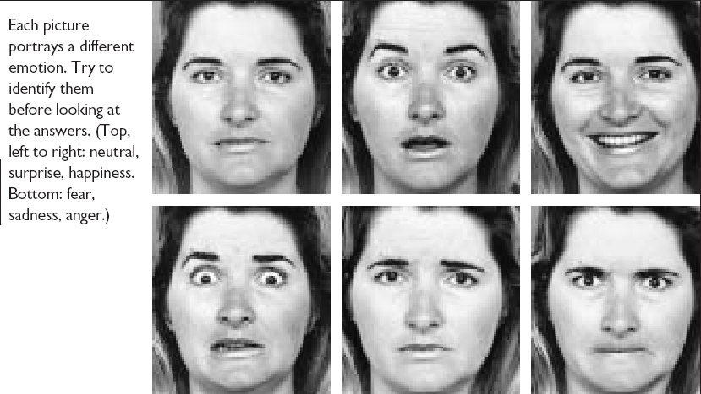
Facial Expressions Convey Emotions

Slide 51
Emotions and
Organizational
Behavior
Felt
Emotions
Displayed
Emotions
Emotional
Labor

Slide 52
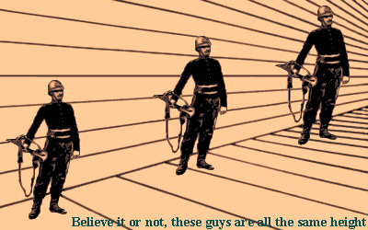
Individual Behavior-Perception

Slide 53
What is Perception?
  A process by which individuals organize and interpret their sensory impressions in order to give meaning to their environment.
Why Is it Important?
  Because people’s behavior is based on their perception of what reality is, not on reality itself.
  The world that is perceived is the world that is behaviorally important.

Slide 54
Factors that Influence Perception
Factors in the Perceiver
  Attitudes
  Motives
  Interests
  Experience
  Expectations
Factors in the situation
  Time
  Work setting
  Social setting
Perception
Factors in the target
  Novelty
  Motion
  Sounds
  Size
  Background
  Proximity

Slide 55
Social Perception
The process through which individuals attempt to combine, integrate, and interpret information about others.

Slide 56
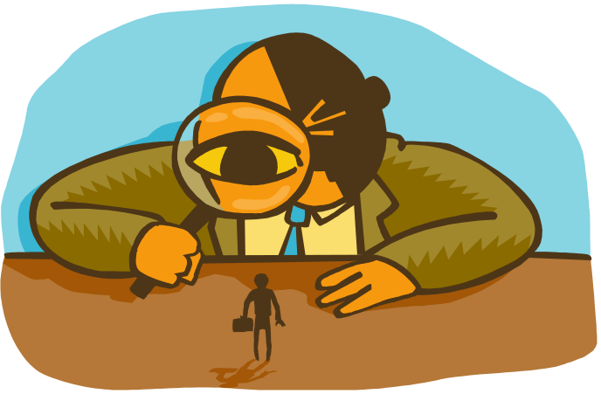
Person Perception: Making Judgments about others

Slide 57
Attribution
The Process through which individuals attempt to determine the causes of others behavior

Slide 58
Fundamental Attribution Error
The tendency to attribute others’ actions to internal causes (e.g their traits) while largely ignoring external factors that also may have influenced their behavior.

Slide 59

Impression Management
Self-presentation
Is the process by which people attempt to manage or control the perceptions other form of them.

Slide 60
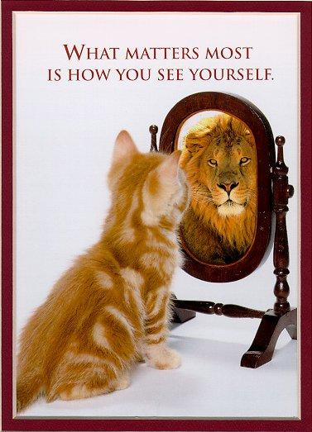

Slide 61
Employee Impression Management Strategies
Demotion-preventative strategies
    Accounts
    Apologies
    Disassociation
Promotion-enhancing strategies
    Entitlement
    Enhancement
    Obstacles disclosures
    Association

Slide 62
Perception & Decision Making

Slide 63
Two Important
Decision-Making Phases
Problem
Identification
Alternative
Development

Slide 64
Methods of Improving Decision Making in Organizations
Human-based Methods
Computer-based Methods
Brainstorming
Nominal Group Technique
Delphi Method

Slide 65
Motivation
The set of processes that arouse, direct and maintain human behavior toward attaining some goal.

Slide 66
Motivational Theories

Slide 67
Why Do We Care?
Ability
PERFORMANCE
Motivation
Opportunity
Performance =
f (Ability, Motivation, Opportunity)
Notes:
Material pertinent to this illustration is found on pages 189-190.

Slide 68
An Integrated Model of Individual Motivation to Work
Amount & schedule of contingent extrinsic rewards
Individual
attributes
Work effort needed
Performance
Motivation
Equity comparison
Satisfaction
Net amount of valent intrinsic rewards
Organizational support

Slide 69

Strategies for
Motivating Employees
Behavior Modification
Job Design

Slide 70
Challenges of motivating employees
Changing workforce
  younger generation employees have different needs and expectations to baby boomers
  people have more diverse values – results in more variety in what motivates employees
Cultural values
  globalisation has added to diversity

Slide 71
Special Issues in Motivation
Motivating Professionals
Motivating Contingent Workers
Motivating the Diversified Workers
Motivating Low-Skilled Service Workers
Motivating People Doing Highly Repetitive Tasks

Slide 72
Implications for Managers
Recognize Individual Differences
Use Goals and Feedback
Allow Employees to Participate in Decisions that Affect Them
Link Rewards to Performance
Check the System for Equity

Slide 73
Understand
organizational
events
Organizational
Behavior
Research
Influence
organizational
events
Predict
organizational
events

Slide 74
Basic OB Model
Organization
systems level
Group
level
Individual
level

Slide 75
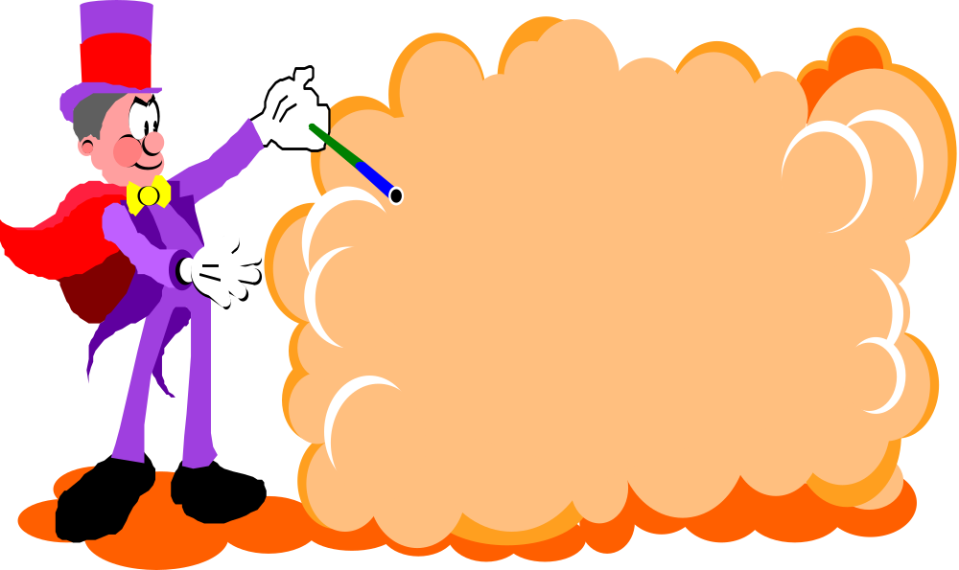
Enough for today. . .

Slide 76
Next….

Slide 77
Organizational Behavior
(MGT-502)
Lecture-16

